Slide 1
Adult Census Income Prediction

Slide 2
OBJECTIVE:
Adult Census Income Prediction project is to predict an individual's income level (whether it is above or below $50,000 per year) based on their demographic and employment information. This prediction can have various applications, such as targeted marketing, creditworthiness assessment, and public policy decision-making
BENEFIT:
Accurate income prediction:
Targeted marketing
Public policy decision-making:
Recipe recommendations:
Efficient data processing

Slide 3
Data Sharing Agreement :
Data description
Data ownership
Data use:
Data protection
Data sharing restrictions
Data retention and destruction
Governing law:

Slide 4
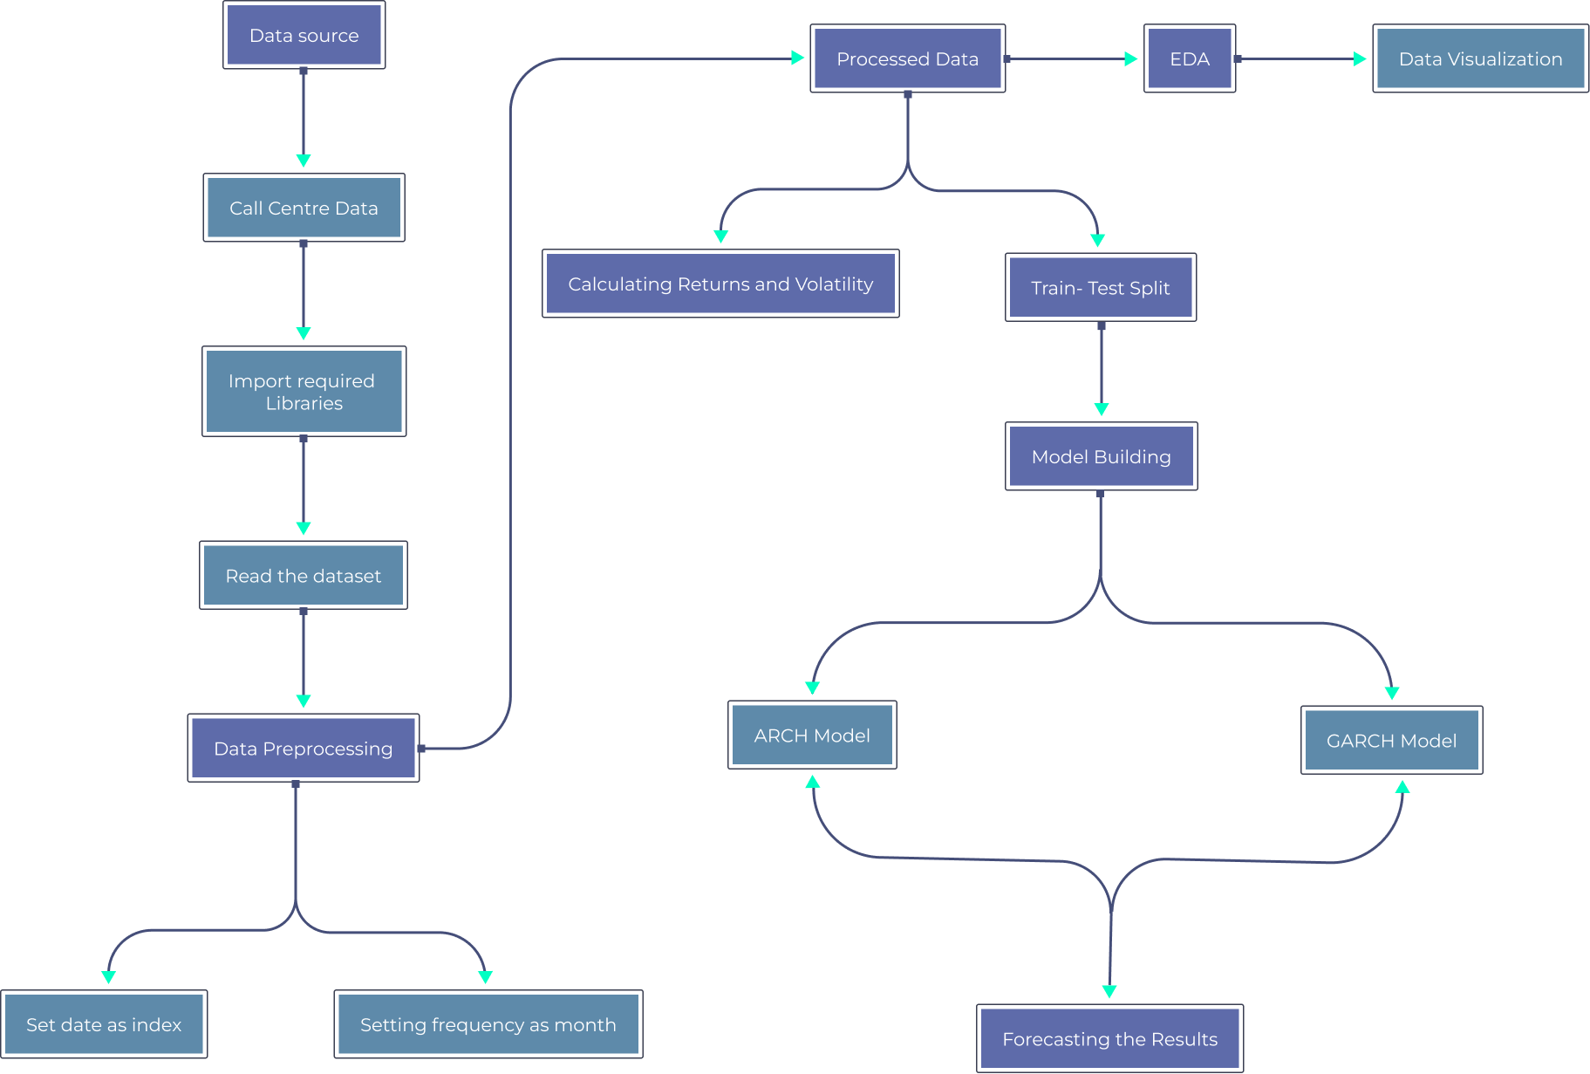
Architecture:

Slide 5
Data Validation and Data Transformation :
Data Validation:
Data validation is the process of ensuring that the data being used is accurate, complete, and consistent.
In the case of the Adult Census Income Prediction project, data validation may involve checking for missing values, outliers, or other anomalies that could affect the accuracy of the predictive model.
Data Transformation:
Data transformation is the process of converting data from one format or structure to another.
In the case of the Adult Census Income Prediction project, data transformation may involve combining multiple data sources, removing redundant data, or converting data into a format that can be used by the predictive model.

Slide 6
Data Insertion in Database:
Data insertion involves taking the data collected through web scraping, data pre-processing, and other data transformation activities and storing it in a database for use in building the predictive model.
The database used for this project should be chosen based on factors such as data volume, data complexity, and scalability requirements.
Common database systems used for machine learning projects include MySQL, PostgreSQL, and MongoDB.

Slide 7
Model Training:
Data Export from Db :
1.The accumulated data from db is exported in csv format for model training
Data Preprocessing
Performing EDA to get insight of data like identifying distribution , outliers ,trend
among data etc.
2.Check for null values in the columns. If present impute the null values.
3.Encode the categorical values with numeric values.
4.Perform Standard Scalar to scale down the values.

Slide 8
Model Selection
After the clusters are created, we find the best model for each cluster. By using 2
algorithms “SVM” and "XGBoost". For each cluster both the hyper tunned
algorithms are used. We calculate the AUC scores for both models and select the
model with the best score. Similarly, the model is selected for each cluster. All
the models for every cluster are saved for use in prediction

Slide 9
Prediction:
The testing files are shared in the batches and we perform the same Validation
operations ,data transformation and data insertion on them.
The accumulated data from db is exported in csv format for prediction
We perform data pre-processing techniques on it.
KMeans model created during training is loaded and clusters for the preprocessed
data is predicted
Based on the cluster number respective model is loaded and is used to predict the
data for that cluster.
Once the prediction is done for all the clusters. The predictions are saved in csv
format and shared.

Slide 10
Q & A
1: What is the purpose of the Adult Census Income Prediction project?
Ans: The purpose of this project is to develop a machine learning model that can predict an individual's income based on demographic and other relevant data from the U.S. Census.
2: What are some potential use cases for the Adult Census Income Prediction model?
Ans: The model could be used by government agencies, non-profit organizations, or researchers to better understand income disparities and develop policies or interventions to address them. It could also be used by businesses or marketers to target products or services to specific income groups.
3: What types of data will the Adult Census Income Prediction model use?
A:ns The model will use data from the U.S. Census, including demographic information such as age, education level, occupation, and marital status, as well as other factors such as race and gender.

Slide 11
4.: What machine learning algorithms or models will be used for the Adult Census Income Prediction model?
Ans: This will depend on the specific goals and requirements of the project, but common algorithms for binary classification tasks such as income prediction include logistic regression, decision trees, and support vector machines.
5.: How will the accuracy of the Adult Census Income Prediction model be evaluated?
Ans: The model's accuracy will be evaluated using metrics such as precision, recall, F1 score, and receiver operating characteristic (ROC) curve analysis. The model will also be tested on a separate dataset to ensure it can generalize to new data.

